Slide 1
SQL Capstone Course Presentation – CoolTShirts: A Breakdown of Attribution
Welcome to Austin Woitte’s SQL From Scratch Project Presentation.
With little direction as to how this presentation is to be structured, we hope you enjoy it.

Slide 2
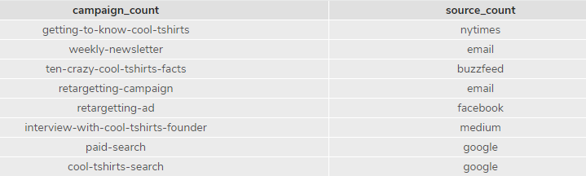
Getting Familiar: How many campaigns and sources does CoolTShirts use? Which source is used for each campaign?
CoolTShirts uses 8 campaigns and 6 sources.
A campaign is the specific ad, pop-up, link or whatever else that is clicked on by the user.
When the user clicks on the campaign, he/she is then taken from the Source (page) to the landing page linked from the campaign ad.

Slide 3
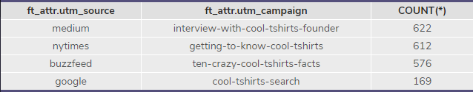
What is the User Journey: How Many First Touches is Each Campaign Responsible For?
A list of First Touches in descending order.

Slide 4
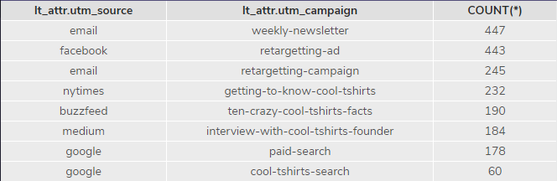
What is the User Journey: How Many Last Touches is Each Campaign Responsible For?
Details showing the count of Last Touches, in descending order

Slide 5

What is the User Journey: How Many Visitors Make a Purchase?
When counting user_id from page_visits table, where the page name is equal to “4 – purchase”, we find that there are 361 users who’ve made a purchase.

Slide 6
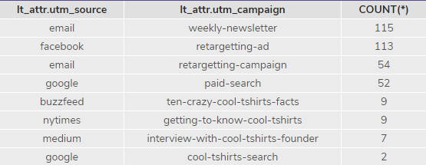
What is the User Journey: How Many Last Touches on the purchase page is Each Campaign Responsible For?
As you can see, the last touch goes down dramatically in regards to being on the purchase page.

Slide 7
What is the User Journey: What is The Typical User Journey?
A typical User Journey looks some thing like:
Amusement attached to a campaign in the form of interest
User clicks ad, is then relocated via website, from source page to CoolTShirts website (Landing page)
User views items and adds to shopping cart
User proceeds to checkout
User purchases product

Slide 8
Optimizing the Campaign Budget: Which 5 Campaigns Should CoolTShirts Re-invest in?
The top four campaigns should definitely be re-invested in.
There is a tie for 5th place with 9 purchases occurring in both of the following:
Ten-crazy-cool-tshirts-facts
Getting-to-know-cool-tshirts
When looking at last touch attribution, however, we can see that ten-crazy-facts has 42 less visitors in the count.
What does this mean?
It would be better to invest in ten-crazy-facts, considering with 40 less people visiting the campaign, they have the same amount of purchases.

Slide 9
Optimizing the Campaign Budget: Which 5 Campaigns Should CoolTShirts Re-invest in? Continued…
The 5 campaigns that should be re-invested in are as follows:
Weekly-newsletter
Retargetting-ad
Retargetting-campaign
Paid-search
Ten-crazy-cool-tshirts-facts

